Slide 1

Optimized Learning with Virtual Reality Summer 2020
Codey Winslow
Dr. Philip Howard

Slide 2
Goal of the Project
Can VR teach industry skills?
Is it a cheap alternative to mocking expensive setups?

Slide 3
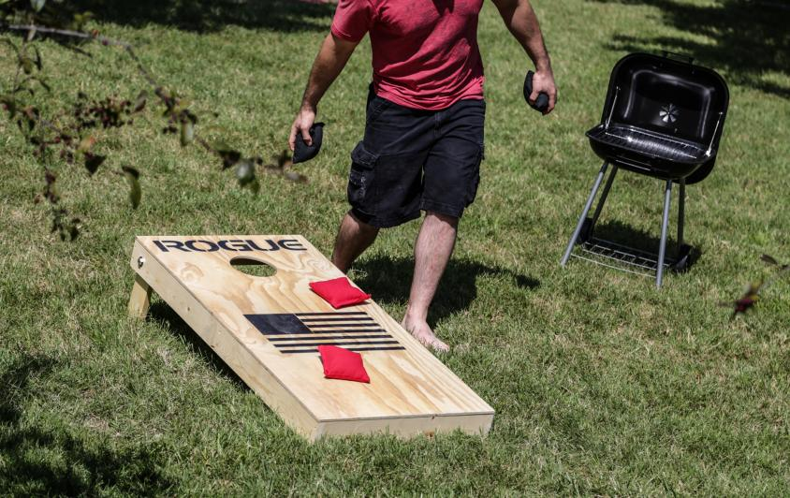
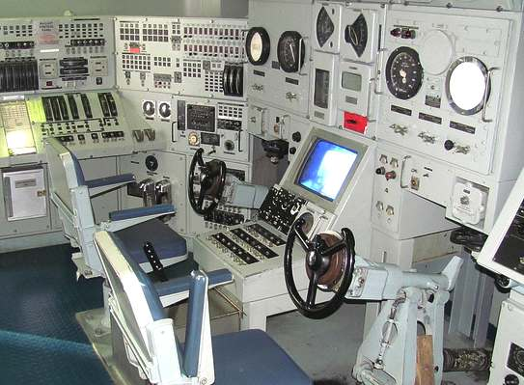
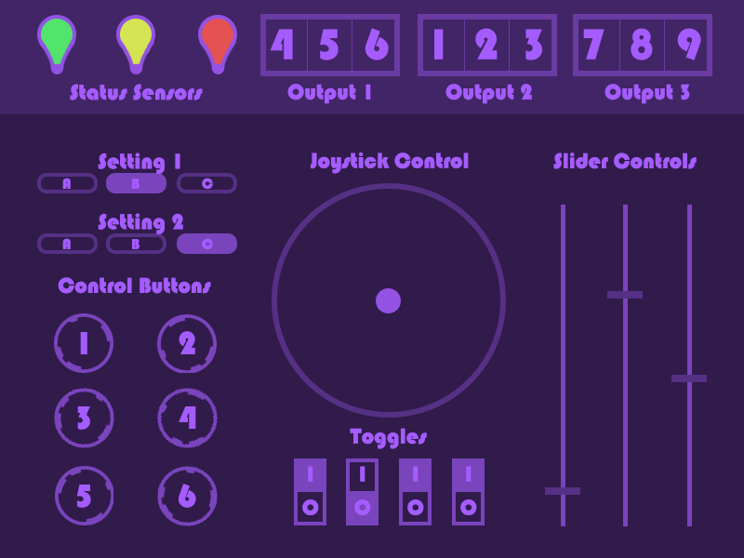
Plans for Execution
Initial
Cornhole
Procedure
Final
Touchscreen
3 Procedures
Simple
Intermediate
Advanced
2020 | Optimized Learning with Virtual Reality | Codey Winslow

Slide 4
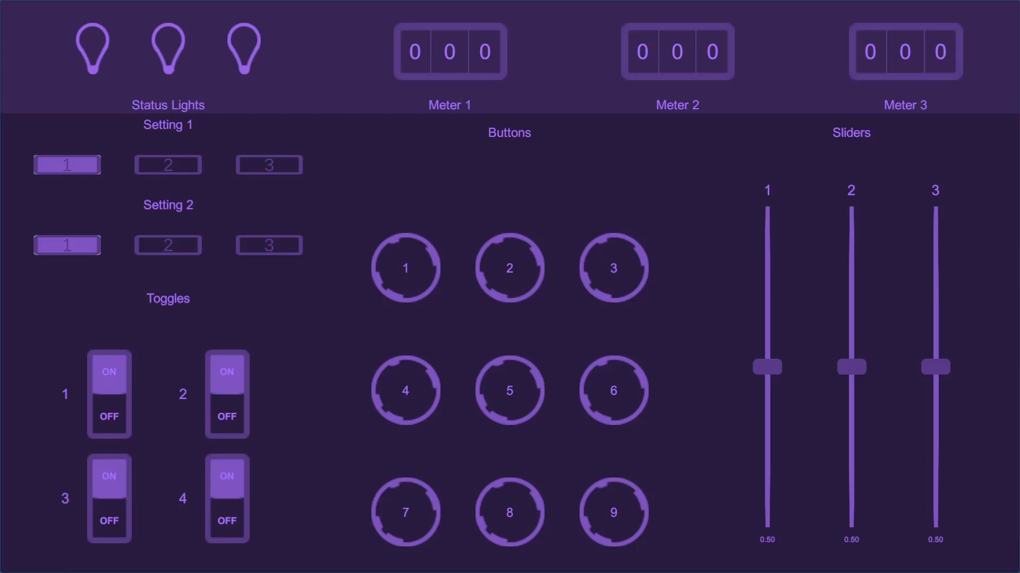
Procedures
Level 1 – Rote Memorization
1. Press button 1
2. Switch toggle 4
2020 | Optimized Learning with Virtual Reality | Codey Winslow

Slide 5
Procedures
Level 2 – Enumerated Rote Memorization
Green light
= sequence 1
Yellow light
= sequence 2
Red light
= sequence 3
2020 | Optimized Learning with Virtual Reality | Codey Winslow

Slide 6
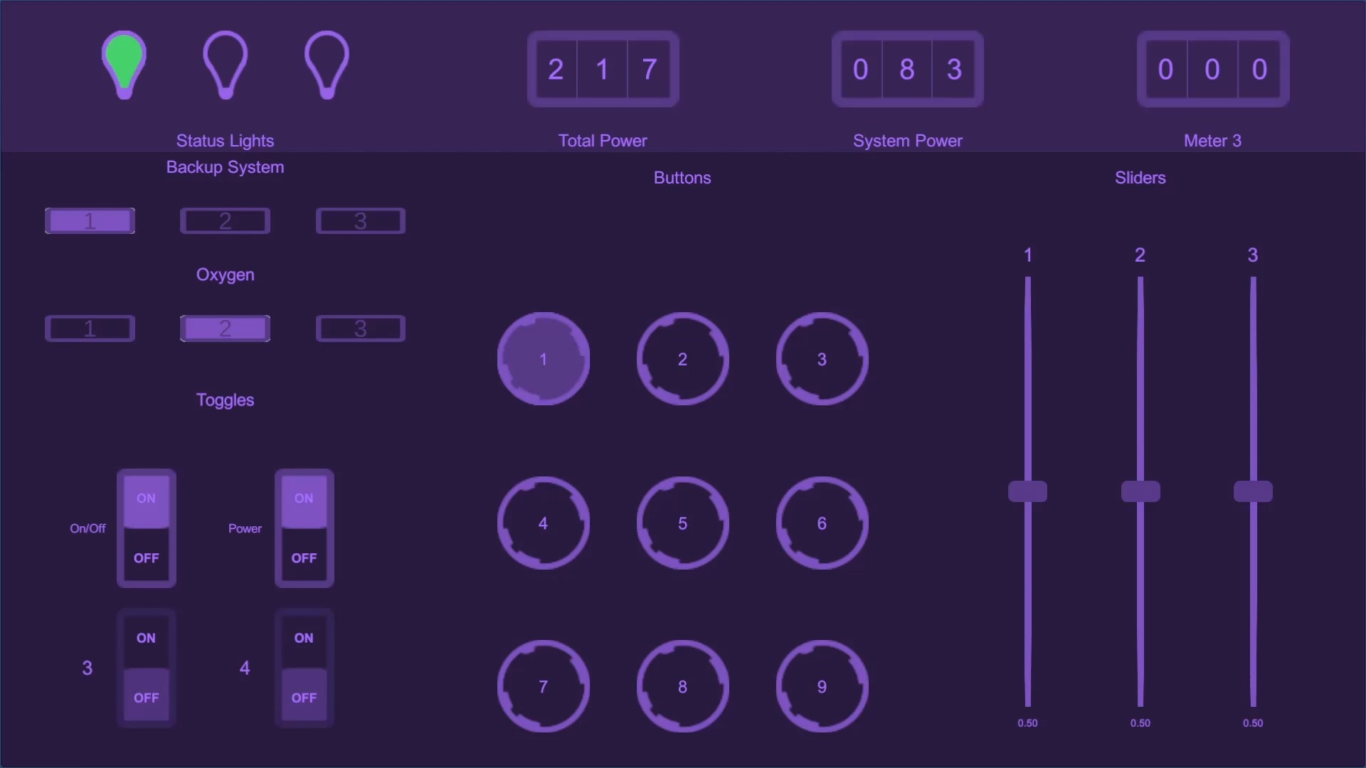
Procedures
Remaining Power
Level 3 – Skill and Judgement
Required Power
System group
View system
Turn on/off
2020 | Optimized Learning with Virtual Reality | Codey Winslow

Slide 7
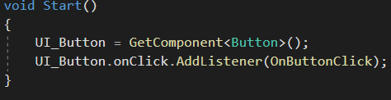
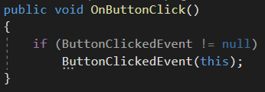
Building the UI
Decorate button click
Trigger event
Observer
notify
Control
trigger
Event
notify
Observer
Procedures
notify
Observer

Slide 8
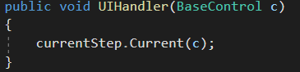
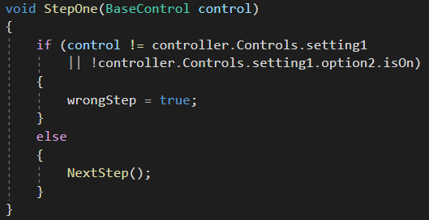
Building the UI – Level 1 Procedure
Call current Step function
Inspect action

Slide 9
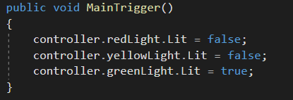
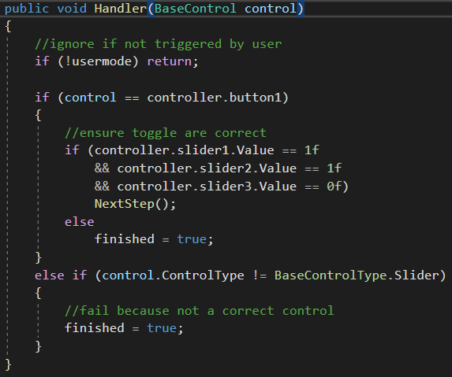
Building the UI – Level 2 Procedure
MainTrigger is called when task starts
Handler inspects all UI actions

Slide 10
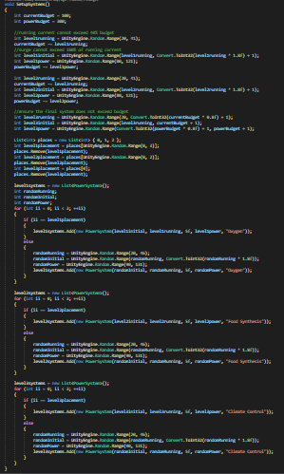
Building the UI – Level 3 Procedure
The hard part

Slide 11
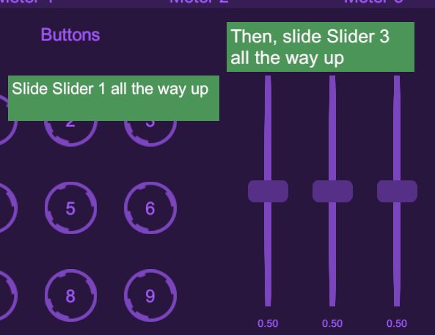
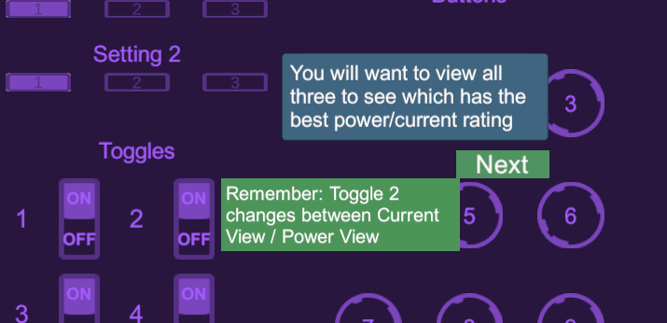
Building the UI – Tutorials
Hints for what to do next
Next buttons to move on

Slide 12

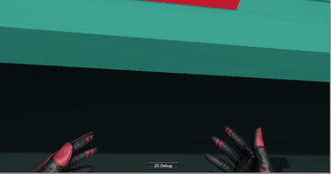
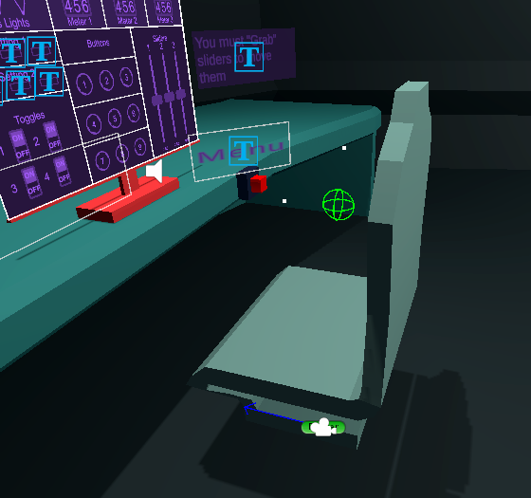
Implementing VR Behavior

Slide 13
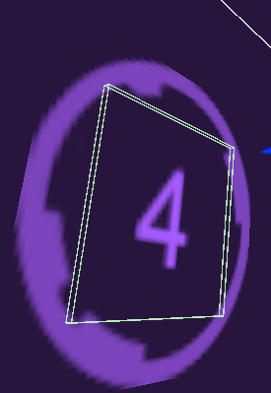
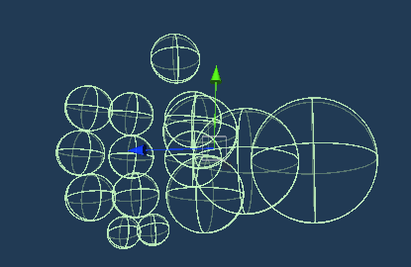
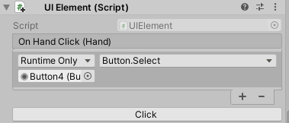
Implementing VR Behavior - Touchscreen
Touchscreen Button Collider
Hand colliders
Component captures hand collision

Slide 14
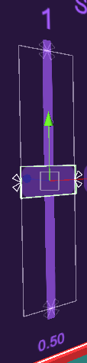
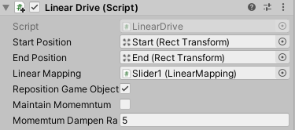
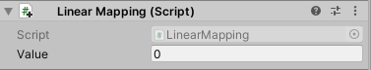
Implementing VR Behavior - Sliders
end
Updates value of component
start

Slide 15

Testing

Slide 16
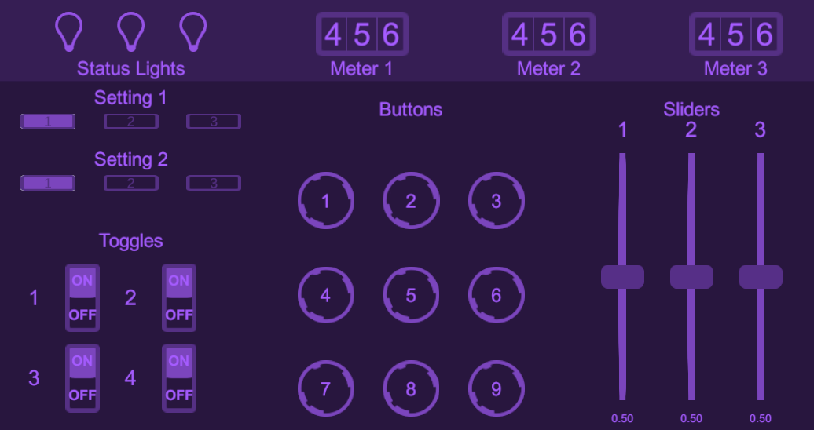
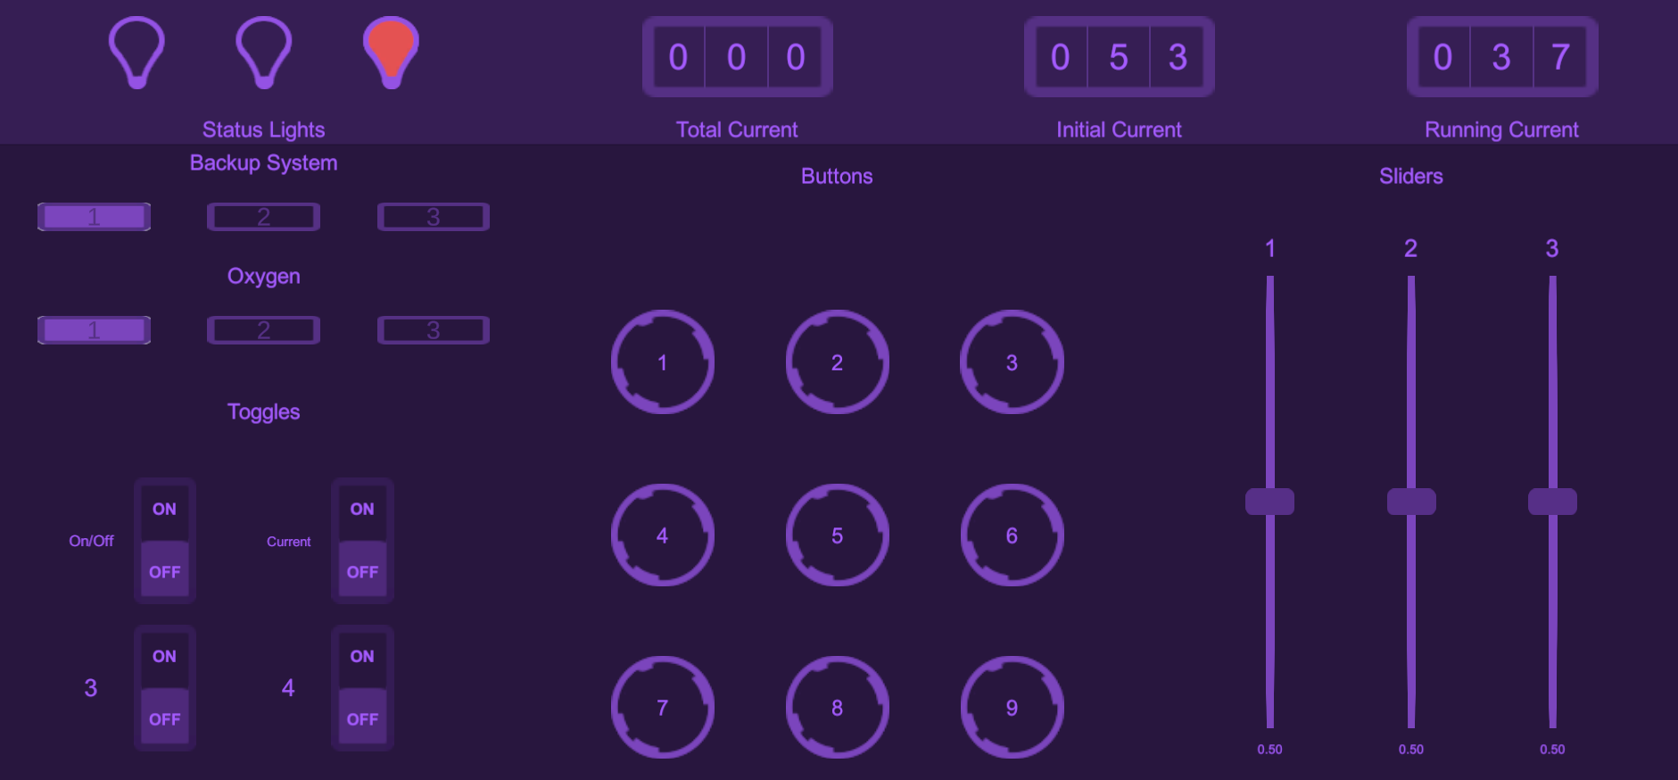
Testing
Not descriptive
More helpful

Slide 17
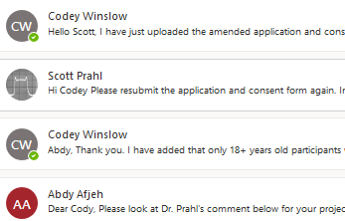
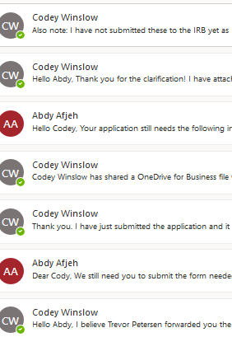
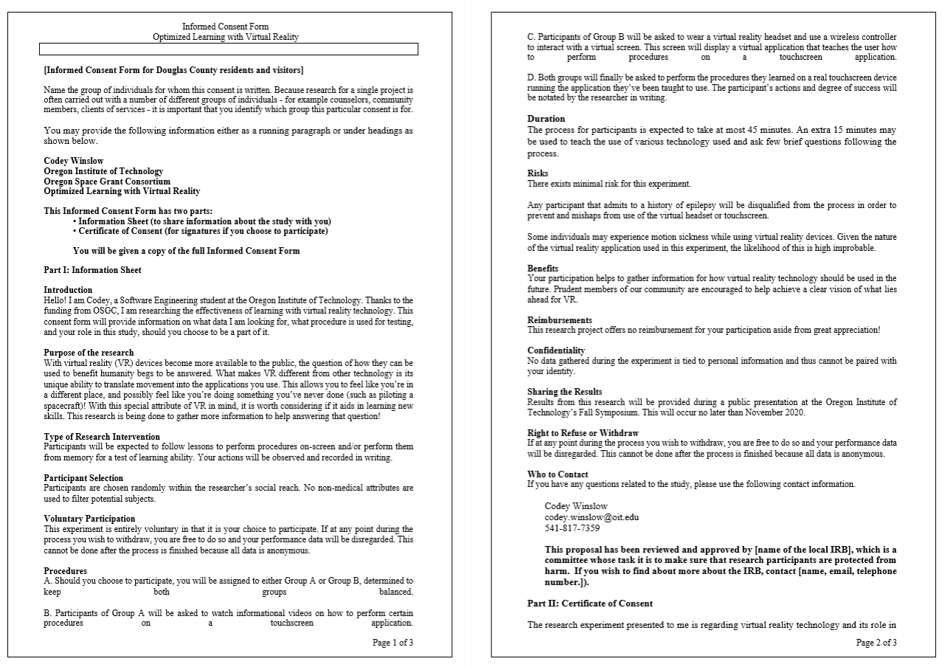
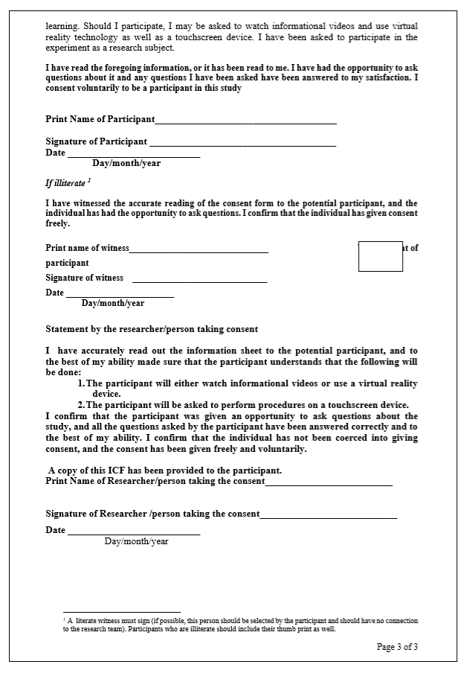
Human Subject Approval
2 weeks of emailing
Informed Consent Form

Slide 18
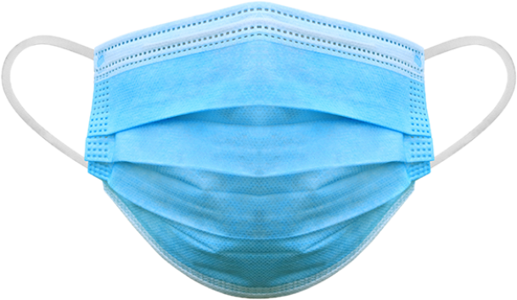


Worthwhile Experience
Deal with distractions
Build focusing skills

Slide 19
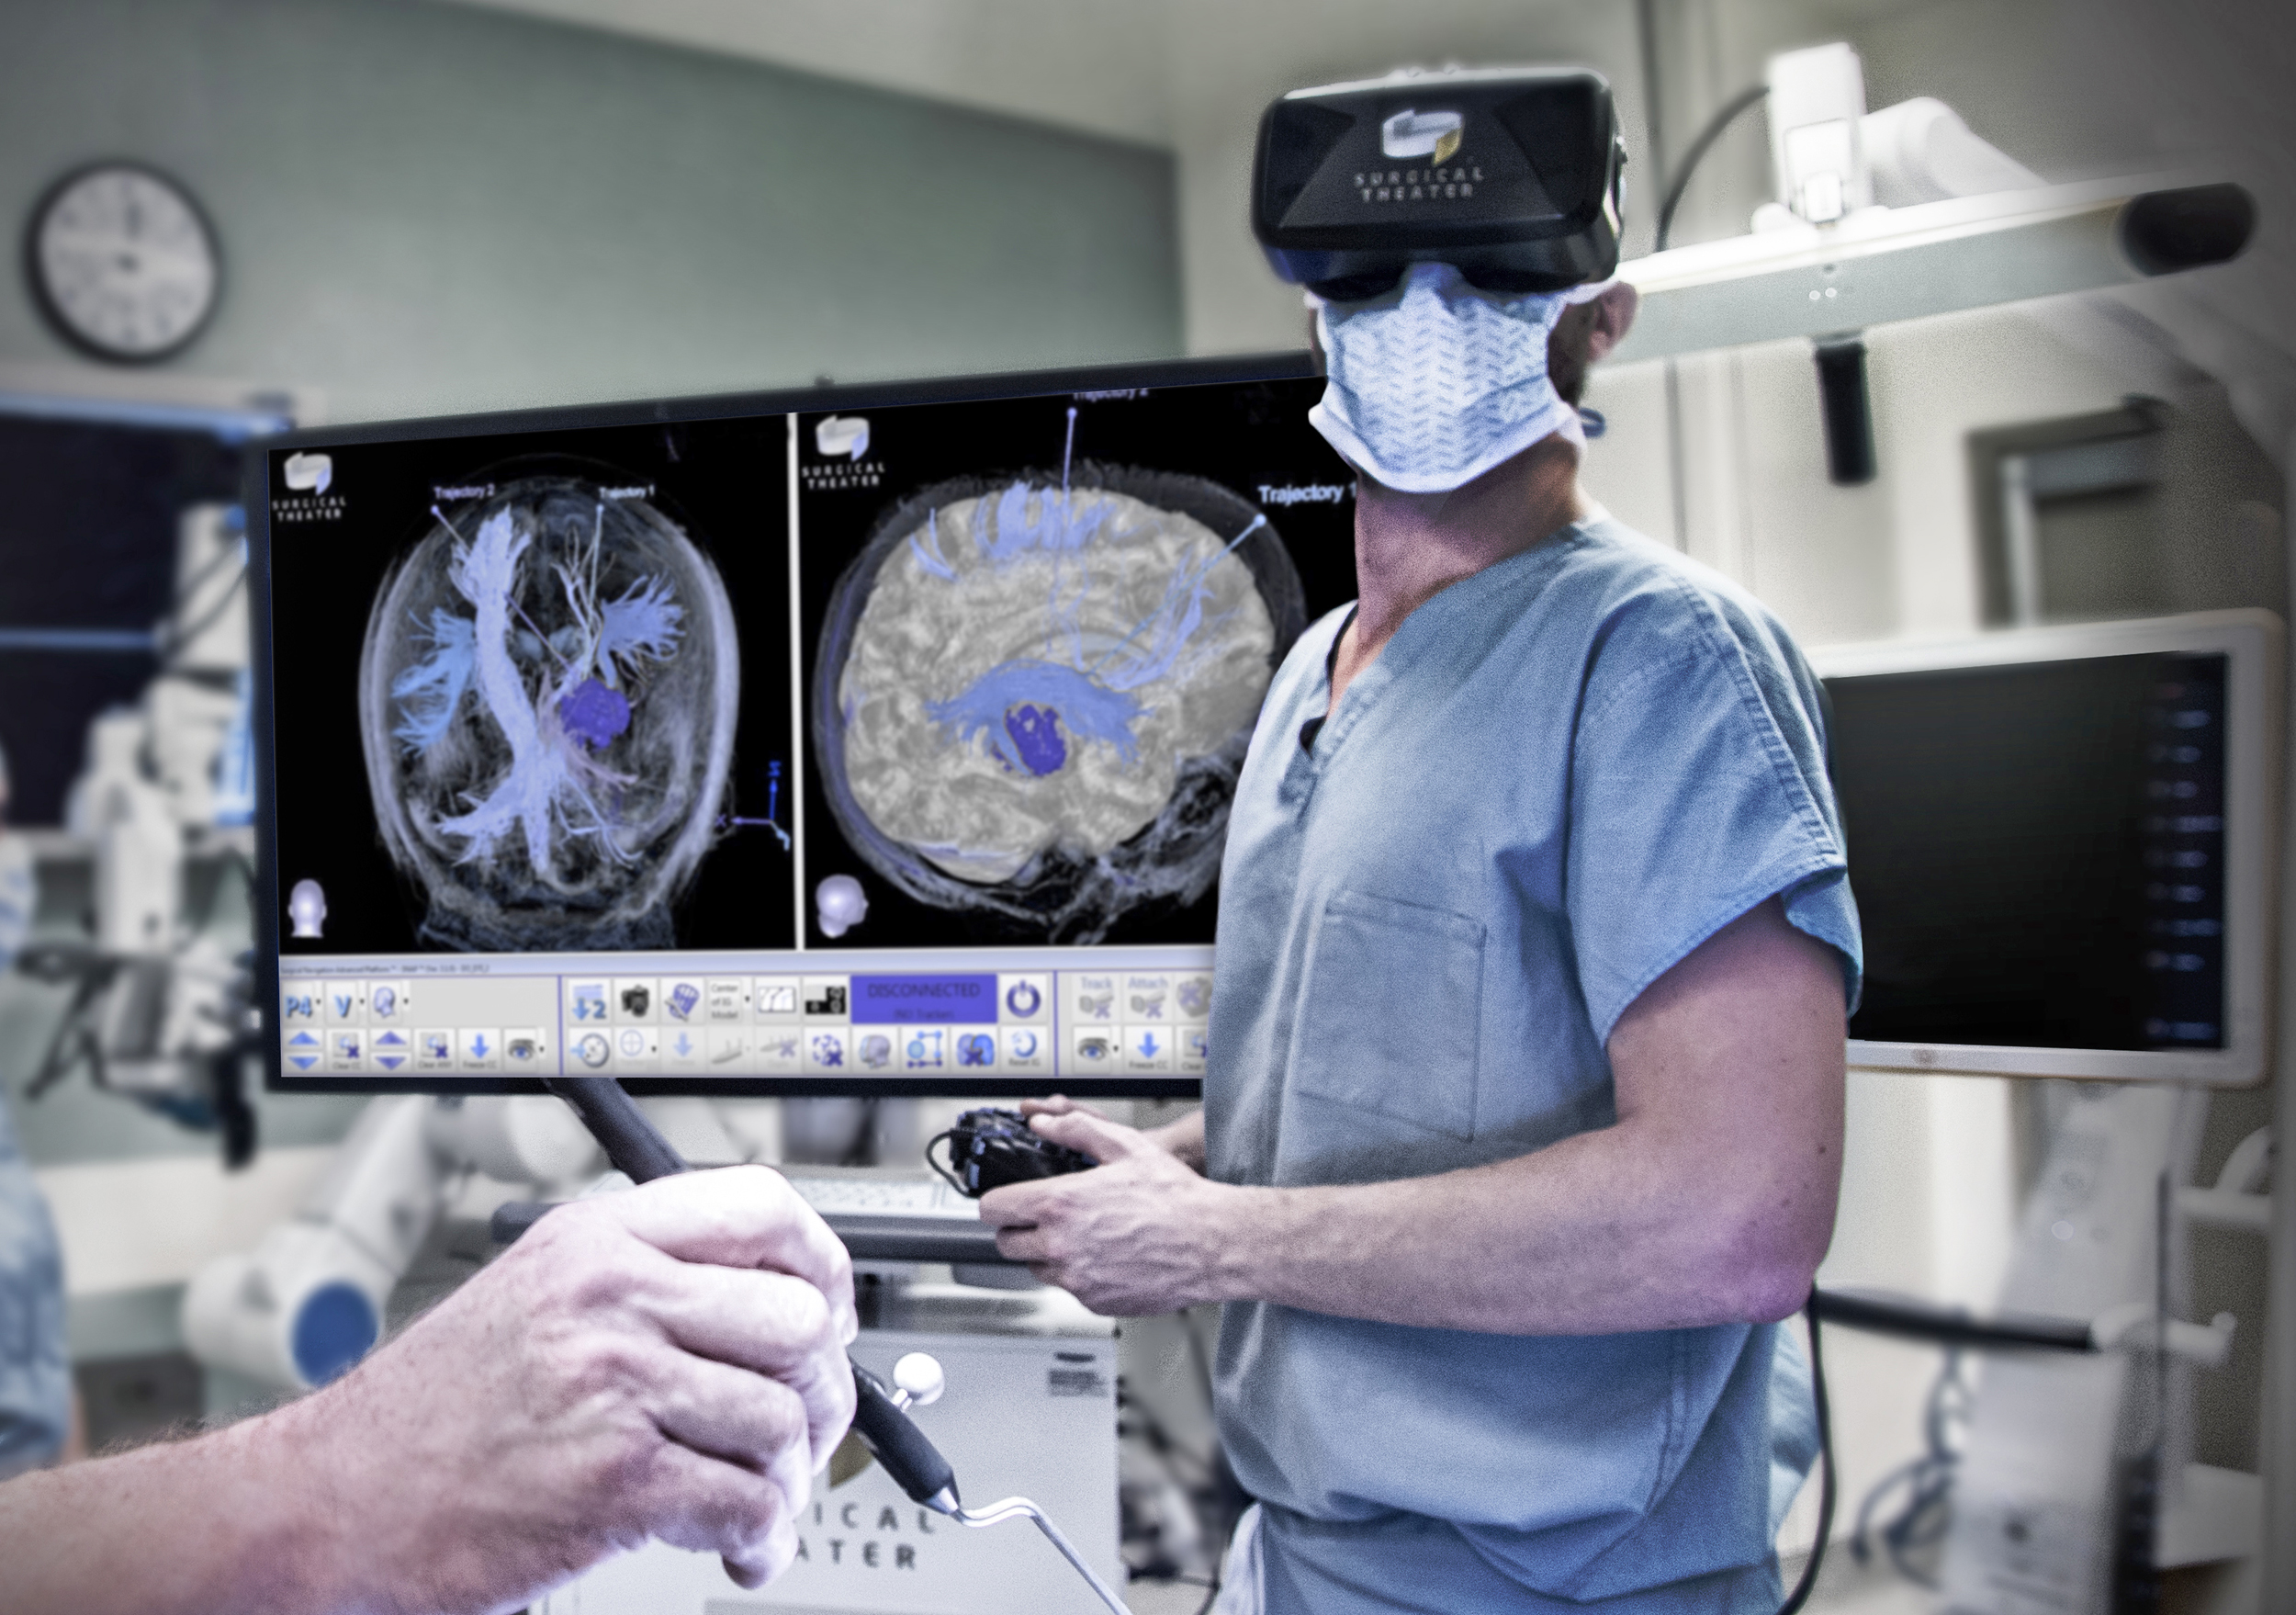

What Lies Ahead
Can physical skills be learned better in VR?
What other potentials does VR technology hold?

Slide 20
Thanks for coming!
Questions? (2 min)
Contact me at codey.winslow@oit.edu

